Slide 1
Device Security System
Ahmednagar jilha Maratha vidya prasarak samaj’s
New Arts, Commerce & Science
College ahmednagar
Submitted By :-
Mr. Auti Vishal Namdev
Mr. Chaudhari Rohan Dattatray
Mr. Dhoke Saurabh Vilas
Under the Guidence of :
Prof. Arun Gangarde Sir

Slide 2
Introduction
By using this Device Security System we can protect our device from anyone else who trying to turn on / boot the system . This system recognize the and identify the Face , if it is registered in the Device Security System , then and then only you can open anything / files in that system . If it does not detect any face in the camera … then it will atomatically shut down the system and send the screenshot of screen to the owner . If it identifies or match the the face then you can use your system normally. If system identifies the face does not matches then it will play the ciren and check if network is available or not if yes then it will send image to the owner of system and shutdown the system At any situation it will protect the system from being booted by someone else.

Slide 3
Scope of the Proposed System:
The main scope and deliverables of the project would be to:
Understand and prepare detailed requirement and specifications
Prepare high level and detailed design specifications of the system
Prepare Test Plan and Test cases
Develop the system and coding
Perform unit testing, integration and system testing

Slide 4
Objectives of the Proposed System:
The main objective of the project is to develop software that Protect the our System from unauthorised owner.
To store the record , pictures and screenshots of the unauthorised owner.
Also ,if system is on by unauthorised owner then it will immediately send Alert Msg to the Owner by Mail.
To develop easy to use software which Protects the Systems / Personal Computers / Laptops in a effective manner.
To develop a user friendly system that requires minimal user training . Most of features and function are similar to those on any Linux platform

Slide 5
Hardware Interface :
Hardware requirements for running this project are as follows:
Processor: - Pentium I or above.
RAM: - 4 GB or above.
HD: - 20 GB or above.
Software Interface:-
Software required to make working of product is:-
Front End : Python
Back End : Python
Version Used : Python 3.10

Slide 6
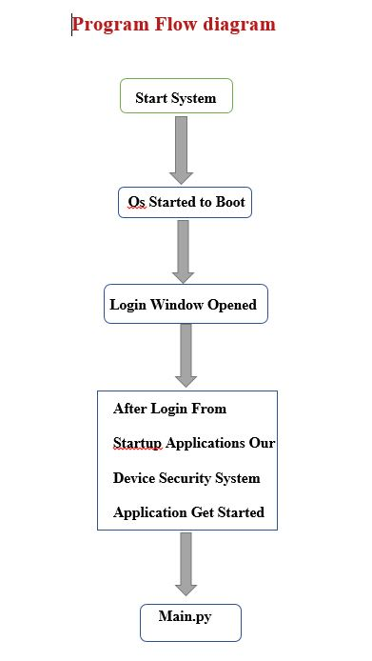
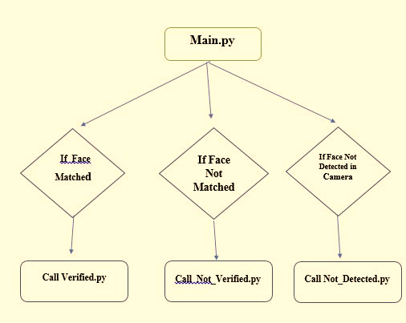
Program Flow Diagram

Slide 7
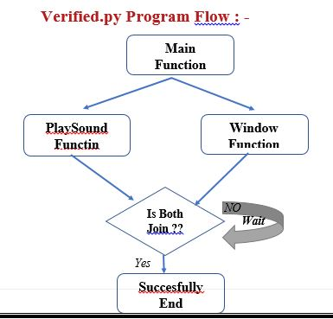
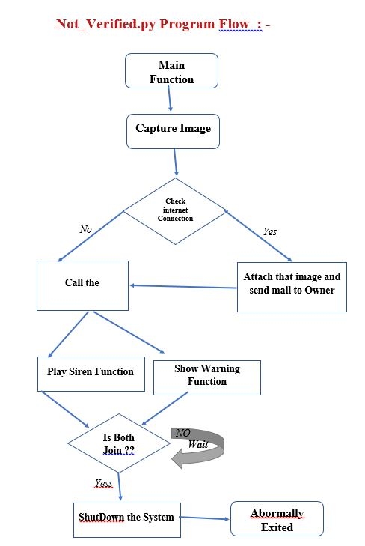

Slide 8
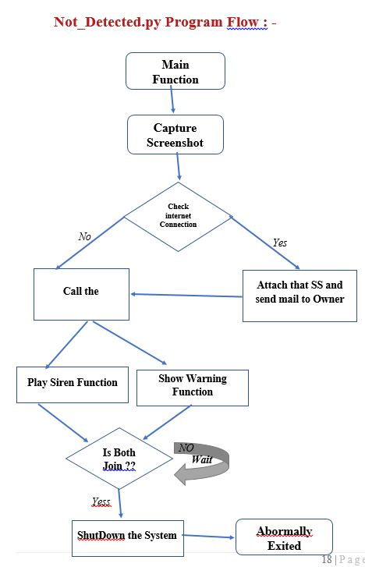

Slide 9
Pre-requisites :-
There are some pre-requisites to run this application, below are the some mandatory thing which you must have otherwise, this application cant run….
Your System/Personal Computer / laptop / must have a Camera.
Second one is , in your system latest version of python installed. (here we used python 3.10).
[https://www.python.org/downloads/release/python-3100/]
Third one is , pip module installer must installed on system. Open terminal use below command to install pip :
( sudo apt-get -y install python3-pip)
After this , some packages / modules you need to download and install on system.

Slide 10
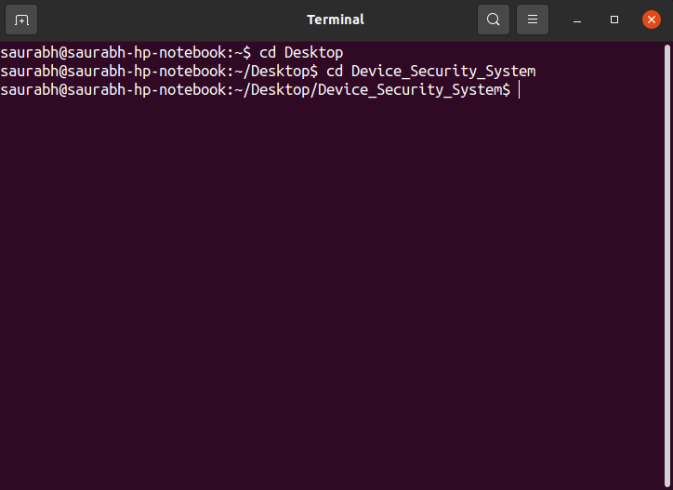
How to Run this Application :
First of all open the terminal ,
Then go to that location where ,our application is stored, by using cd command, like ….
cd desktop
cd Device_Security_System

Slide 11
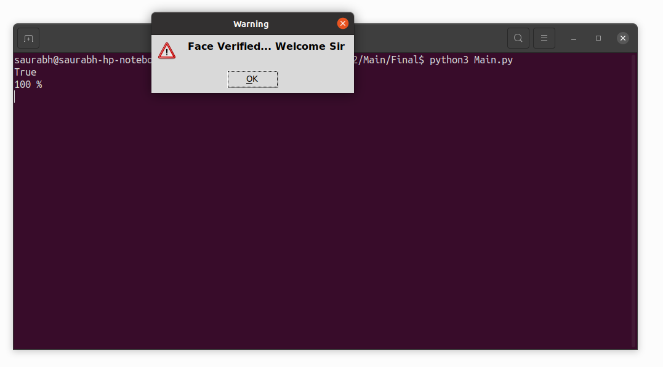
Then run the application by using below command on terminal …
python3 Main.py
After this command execution of our application is get started.
Then after face verification , there are 3 types of outputs, in which..
if face verified successfully , then Application says welcome sir and show the msg box of welcome , like …

Slide 12
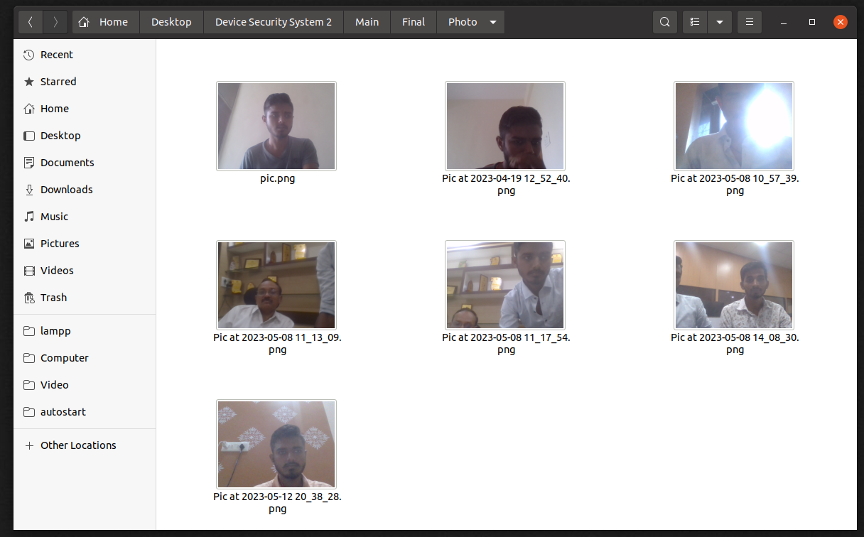
If face is not verified successfully , means your are not a owner of this system, then your photo is get captured and and store that image into Photo Directory….

Slide 13
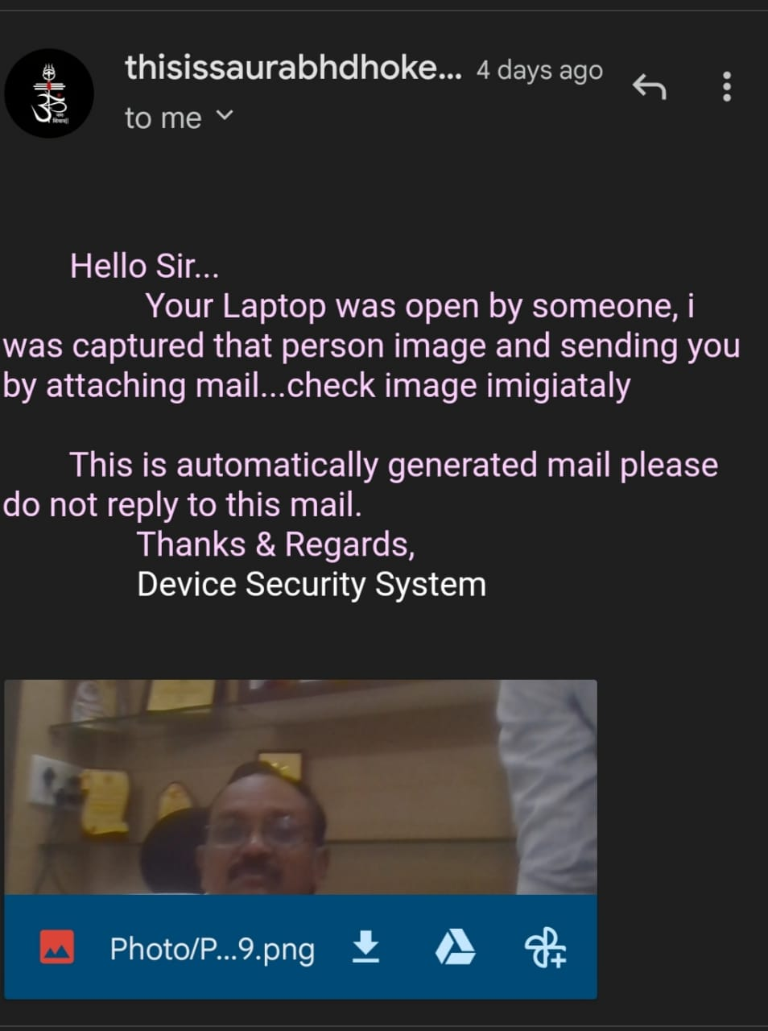
And Application sends that image to the owner of this system through Mail

Slide 14
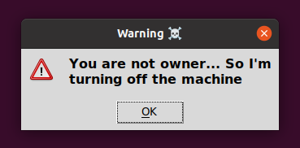

After this Application Plays the Siren and shows the Alert window on the screen like…
When mail send and window is shown then Application directly shutdown the System within 5 Seconds..and unauthorised owner cant stop this shutdown

Slide 15
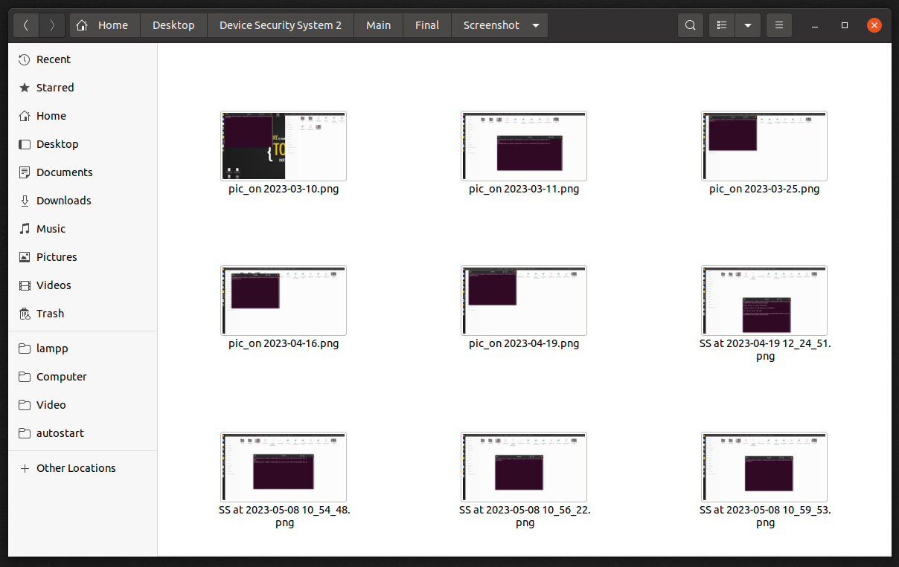
If face is not detected in the camera , means unauthorised user/ owner started the system by hiding his face from camera then Screenshot is get captured by Application and store that Screenshot into ScreenShot Directory….

Slide 16
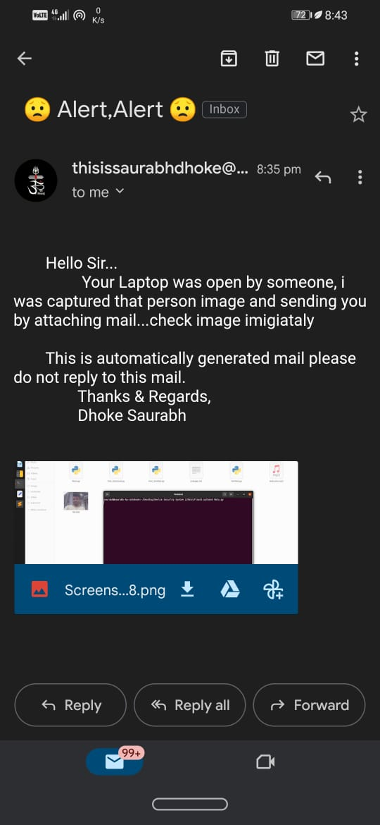
And Application sends that Screenshot to the owner of this system through Mail…

Slide 17
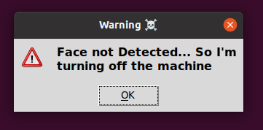
After this Application Plays the Siren and shows the Alert window on the screen like…
When mail send and window is shown then Application directly shutdown the System within 5 Seconds..and unauthorised owner cant stop this shutdown

Slide 18
Future Scope
Software development is never –ending process and continues the life of the software as per the changing needs of the user from time to time. The project is no doubt has been developed keeping in mind easy modification and enhancement that may be required from time to time.
However, there are many scopes to modify this software. As because due to shortage of time, we here become unable to include many things. We are trying to cover all their existing system for keeping records of the members enrolls but due to shortage of time we become unable to include many things. Due to lake of time I here include none of them and a future scope one can develop these returns which are so much essential. Only with a little more doing it is possible to design the formats for those returns. Moreover, an on-line system will be more helpful to the organization. With almost the same data with only a little modification an on-line system can be designed to fulfill their demands. All these can be considered to be future scope for this project.

Slide 19
Conclusion :-
After implementing the application it will contain the advantages were incomparable to the present contemporary systems used by company. The most admirable feature founded was its simplicity in terms of application to the user but its highly beneficial outputs can’t be ignored. The users will be highly benefited after using the system.
It is hoped that this project will help the future developers to modify and implement the system. After modifying some techniques of the programs, it will give us the best performance as our requirements. The project will be very useful for the users.

Slide 20
References :
Books :
Learning Python, 5th Edition
Python Cookbook
Python Documentation
Websites :
https://www.python.org/
https://www.w3schools.com/python/
https://www.tutorialspoint.com/python/index.html

Slide 21
Thank You ….

